Slide 1
Modifiers
Abu Umair
2119
BSCS 6th (M)

Slide 2

Agenda
Introduction
Why we use modifiers
Modifier Errors

Slide 3
Introduction
A Modifier is a word/phrase/clause which modifies other words in a sentence.
It function as adjectives or adverbs

Slide 4

Example
1. Alex bought a chocolate cake.
2. A brown dog was barking at me aggressively.
3. He played well in the football game.

Slide 5
Why we use modifiers
To give additional information about a verb or a noun in a sentence.
To gain readers attention.

Slide 6
Modifier Errors
1. Misplaced Modifiers:
When a modifier is Illogically and unintentionally modifying a word.
Example:
Misplaced: She saw a puppy and a kitten on the way to the store.
Correct: On the way to the store, she saw a puppy and a kitten.

Slide 7
Modifier Errors
2. Dangling Modifiers:
When the subject of the modifier is missing in the phrase or sentence.
Example:
Misplaced: Fumbling in her purse, the keys could not be found.
Correct: Fumbling in her purse, she could not find her keys.

Slide 8
Conclusion
Modifier tends to be descriptive words.
It Clarifies a particular word used in a sentence.
Be careful about the placement of the modifiers

Slide 9
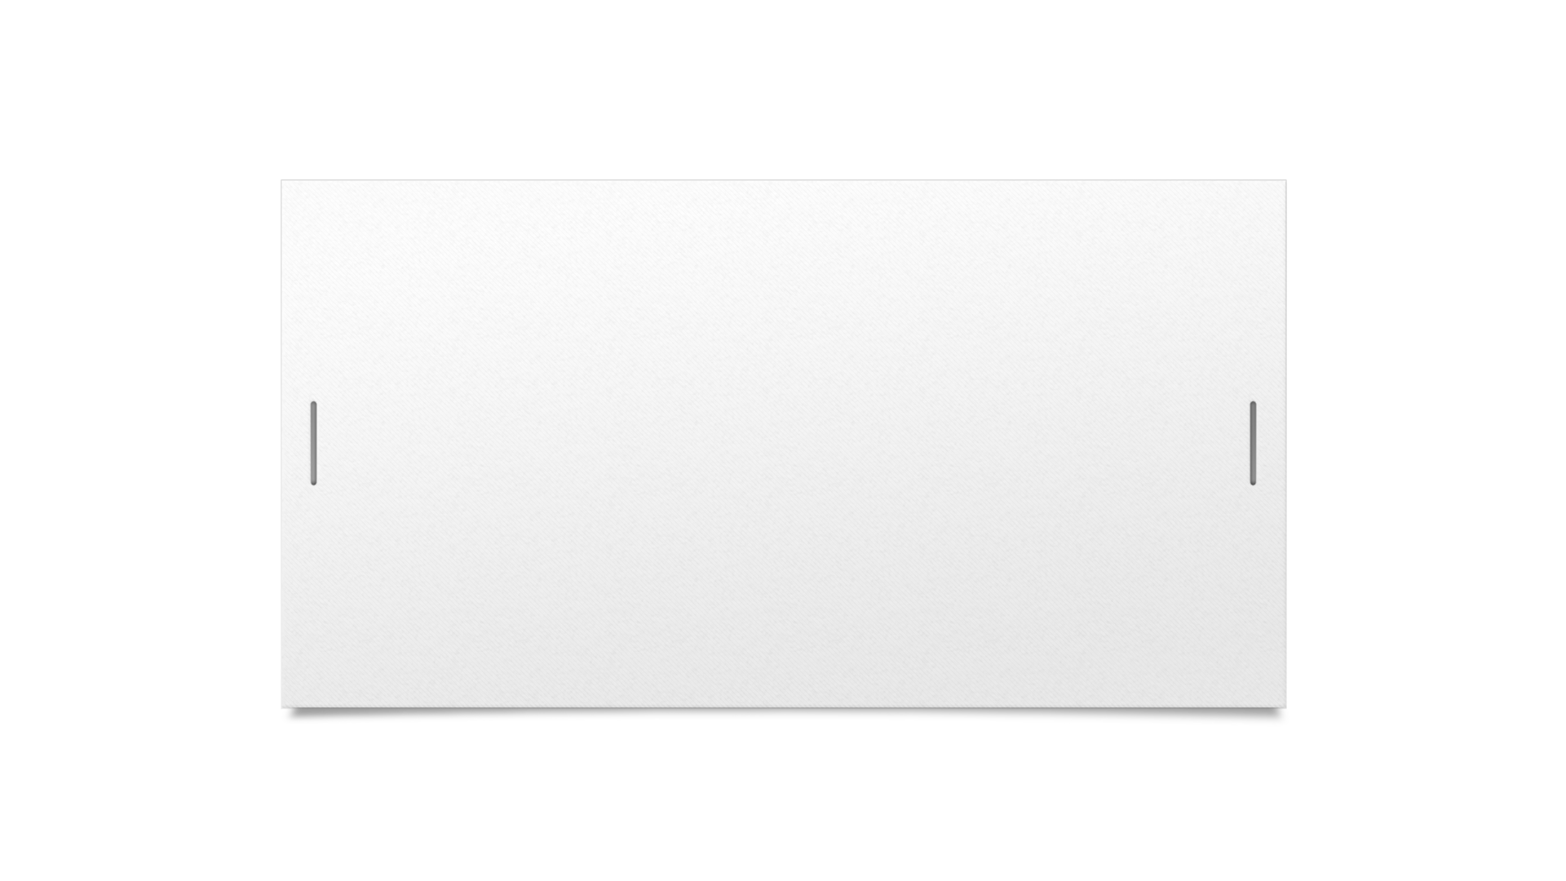



Questions?

Slide 10
Thank You

